Slide 1


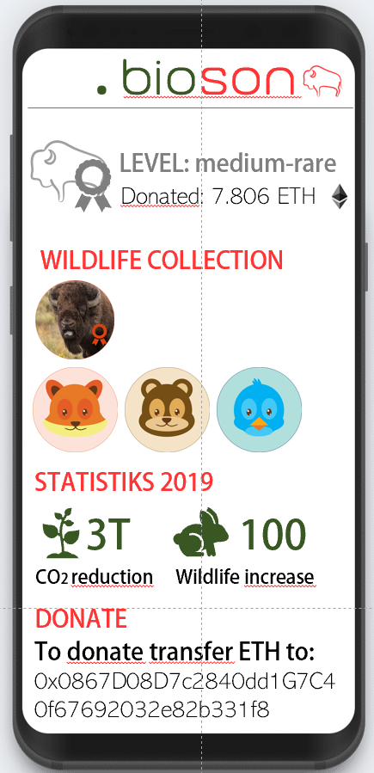
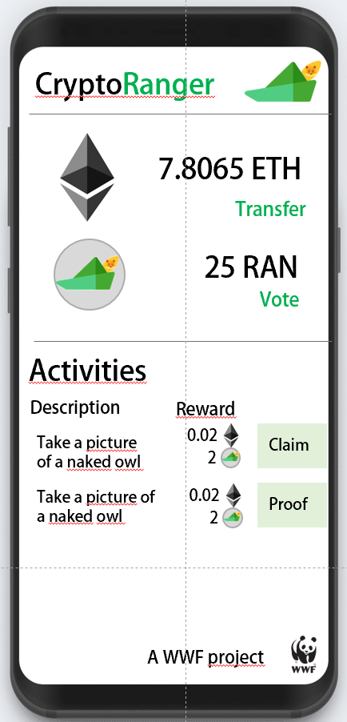
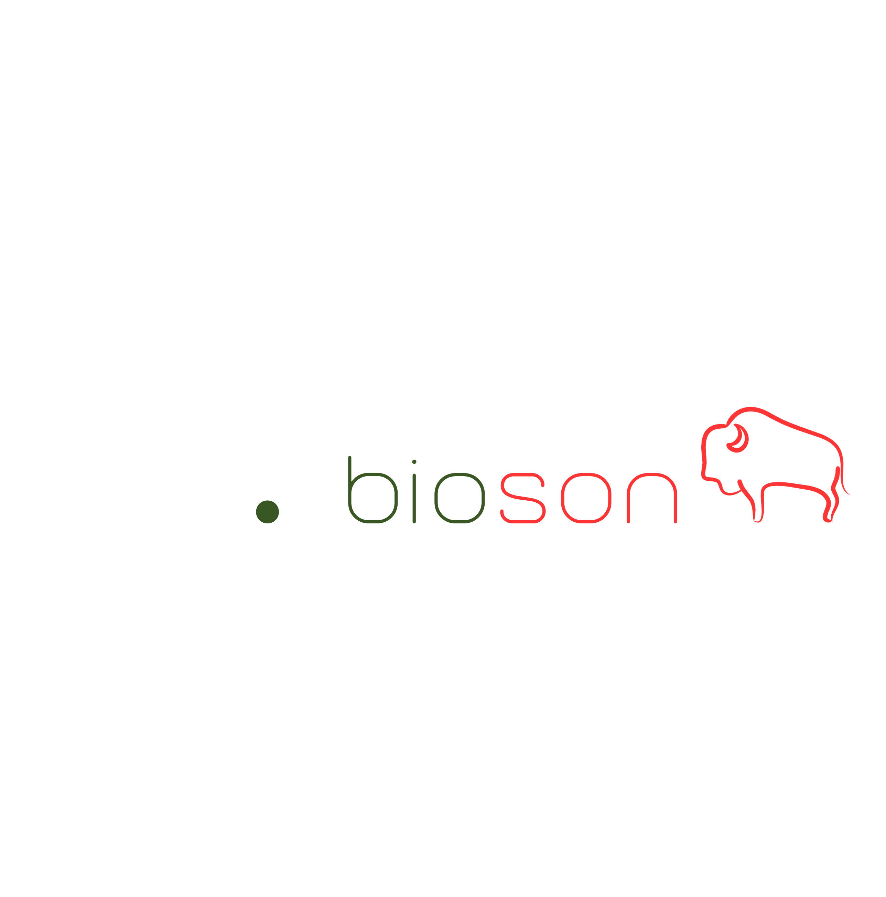
Project Byson – WWF Challenge
https://github.com/betherworld/byson
The WWF Challenge
Trust: Currently, donors rely on WWF’s good faith. Nothing ensures them that their money will be well spent. Distributed Ledgers overcome the issue, taking the trusted third party out of the equation.
Incentive design: data hunters, or Rangers as we like to call them, receive both short-term economic incentives (ether) and voting right (RangerToken) for future development projects in their area.
Proving mechanisms: IoT devices installed by Rangers are used to monitor the area and certify when certain impact goals are met. In this virtuous circle, Rangers help themselves and donors to receive bether, more trustworthy and transparent proofs.
Gamification: unique collectibles (CryptoBisons and Wildlife Tokens) promote donations and create an emotional bond with nature!
Energy efficiency: we only use the Ethereum Blockchain for transaction processing. Data is stored in BigchainDB and IPFS
Alessandro
Tarantola
Chaoran
Chen
David
Ittah
Sergiu
Soima
Severin
Kranz

Slide 2
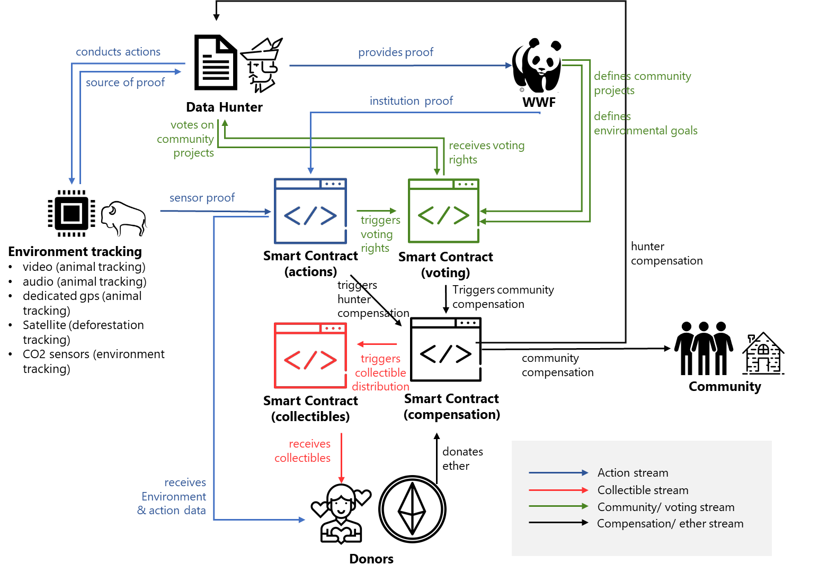
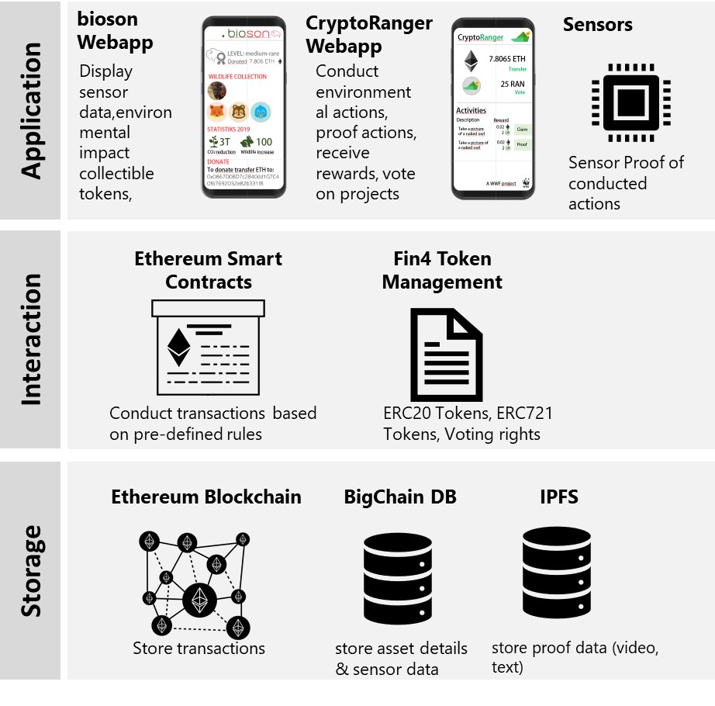
Crypto-Economic Design
System Architecture
The Idea
The goal of the project is threefold: incentivize locals to become an active part in environmental preservation; promote donations; grant total transparency to all involved parties. The first one is achieved by rewarding useful actions performed by locals with money, as well as the possibility to actively shape the future of the community by voting for their favorite project. The second relies on gamification and on the perspective of a future value of the unique CryptoBisons (each linked to a real animal) and Wildlife Tokens. The third exploits the advantages of distributed ledgers, implementing a fully decentralized network shared by a community of peers.

Slide 3


Disruption Potential
For the Environment
For the Community
For the Donors
The digital revolution brought about by the use of DLT-connected technologies might yield an unprecedented impact. The keywords for the new era are:
decentralization, sustainability, transparency. The successful implementation of our model could hopefully generate all three of them: empowering the local community, granting donors total control over their money and providing them with reliable up-to-date data, and protecting the environment in the process.
The manpower provided by the rangers exponentially speeds up the installment of the monitoring system in the area. More control over the area allows WWF to plan more efficient and precise interventions.
Eventually, the local community learns the value of a healthy environment and takes care of it, making the physical presence of a third party (like WWF) unneeded.
Locals can decide to actively contribute to the preservation and development of their area, entering a decentralized alternative governance system that really values their efforts and rewards them in the short (economic incentives) and long term (community projects). The more actions they perform, the more their voting power for sponsored community projects increases.
Donors will have the possibility to specify the percentage of their money that should be allocated to Ranger activities or to community projects. A preset and publicly stated percentage will be retained by WWF to sustain their usual activity in the area.
Overall, they receive decisional power and every mean to check the progresses made with their help…as well as cute and unique non fungible tokens!
Increased manpower for preservation and requalification of the forest
Improved IoT monitoring system
Reduced effort from WWF
Better awareness of Nature’s value and needs
Get paid to install IoT devices or help WWF volunteers in their activities
Obtain voting rights for future community development projects
Contribute to the well-being of nature and humans at once
Have a high influence over how his donation is being used
Receive WildLife Tokens or CryptoBisons
Receive KPI updates for their donations through a dedicated app

Slide 4
Potential Negative Outcomes
Future Work
Challenges
In our final solution, we have 4 smart contracts with 33 different functions, 1100 lines of code, 2 front-end applications and an integration with the Fin4 backend. The main challenge we faced was choosing which features to develop. Another issue was the Fin4 integration. It was rather cumbersome to setup the system and familiarize with it in such a short time.
Error-prone smart contracts
Badly defined tasks for CryptoRangers could harm nature
Tracking of bisons might be misused
Romanians in the mountains may not know how to use the app
Internet connection may be limited in the mountains
Low adoption of ether as a method of payment
Possible high energy consumption if not optimized
Requires some degree of familiarity with technology
Implement social proof mechanisms
Connect the sensors as oracles
Identify optimal incentive parameters
Donors’ voting on projects
CryptoRangers should be able to propose necessary environmental actions
Support a higher amount of non-fungible tokens by additional genes (types of animals, etc.)
Improve incentive system

Slide 5

Software Demo
Listen to the users of our application and checkout our software demo to get an idea of how our ecosystem concept.
https://www.youtube.com/watch?v=96EcTxF43JE

